Slide 1
Logic and Reasoning
Module -4
KNOWLEDGE BASED AGENTS
Logical Agents

Slide 2
Outline
Knowledge-based agents
Wumpus world
Logic in general - models and entailment
Propositional (Boolean) logic
Equivalence, validity, satisfiability
Inference rules and theorem proving
  forward chaining
  backward chaining
  resolution

Slide 3
“Navy sedan with crimson hatches”

Slide 4
“Humans, it seems, know things; and what they know helps them do things.” These are not empty statements.
They make strong claims about how the intelligence of humans is REASONING achieved—not by purely reflex mechanisms but by processes of reasoning that operate on REPRESENTATION internal representations of knowledge.
In AI, this approach to intelligence is embodied in knowledge-based agents.

Slide 5


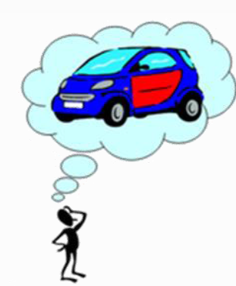

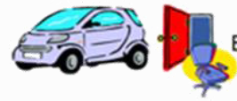
مشکلات وب موجود :
Semantic Matching
Navy = Blue
Crimson = Red
Sedan = Car
Hatch = Door
A Red Car with Blue Doors
A Navy Sedan with Crimson Hatches
A blue Car AND a Red Door
A car,
A Red Door,
A Blue chair

Slide 6
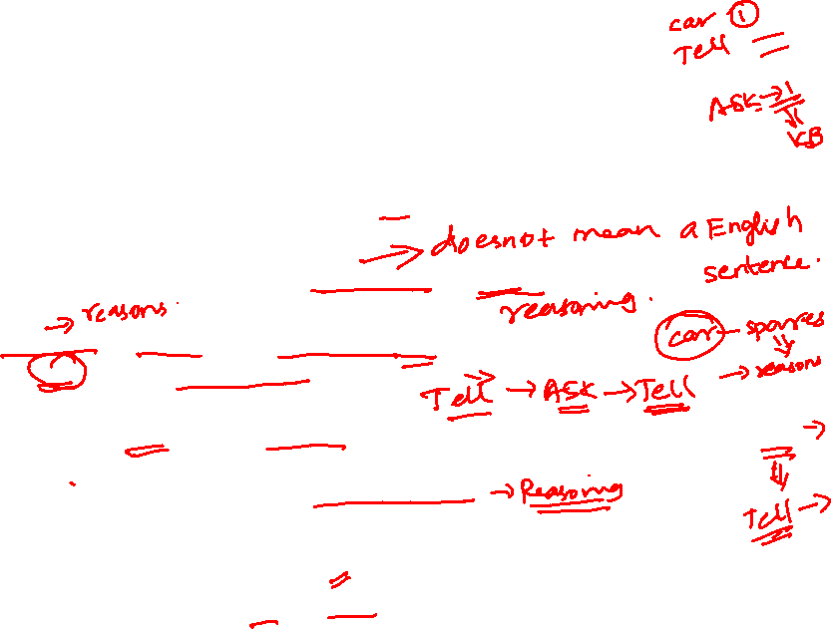

Knowledge bases
Knowledge base(KB) = set of sentences in a formal language
Declarative approach to building an agent (or other system):
  Tell it what it needs to know
Then it can Ask itself what to do next - answers should follow from the KB
Agents can be viewed at the knowledge level
  i.e., what they know, regardless of how it is implemented
Or at the implementation level
  i.e., data structures in KB and algorithms that manipulate them

Slide 7
Knowledge Base Vs Database
More Rules | Less Rules
Facts Less | More Facts
Explicit Rules and Facts | Explicit Facts and Implicit Rules
Experts update | Clerks update
Main Memory Based | Disk Based

Slide 8
Each time the agent program is called, it does three things.
First, it TELLs the knowledge base what it perceives.
Second, it ASKs the knowledge base what action it should perform. In the process of answering this query, extensive reasoning may be done about the current state of the world, about the outcomes of possible action sequences, and so on.
Third, the agent program TELLs the knowledge base which action was chosen, and the agent executes the action.

Slide 9
Knowledge Based Systems
Knowledge based systems are artificial intelligent tools working in a narrow domain to provide intelligent decisions with justification.
Knowledge is acquired and represented using various knowledge representation techniques: rules, frames and scripts.
Knowledge-based systems are systems based on the methods and techniques of Artificial Intelligence. Their core components are the knowledge base and the inference mechanisms

Slide 10
Knowledge Representation
Knowledge representation and knowledge engineering are central to AI research.
Many of the problems machines are expected to solve, will require extensive knowledge about the world.
Among the things that AI needs to represent are: objects, properties, categories and relations between objects; situations, events, states and time; causes and effects; knowledge about knowledge (what we know about what other people know); and many other, less well researched domains.

Slide 11
Issues in Knowledge Representation
How do people represent knowledge?
What is the nature of knowledge and how do we represent it?
Should a representation scheme deal with a particular domain or should it be general purpose?
How expressive is a representation scheme or formal language?
Should the scheme be declarative or procedural?
A knowledge-based agent can be built simply by TELLing it what it needs to know. Starting with an empty knowledge base, the agent designer can TELL sentences one by one DECLARATIVE until the agent knows how to operate in its environment. This is called the declarative approach to system building.
In contrast, the procedural approach encodes desired behaviors directly as program code.

Slide 12

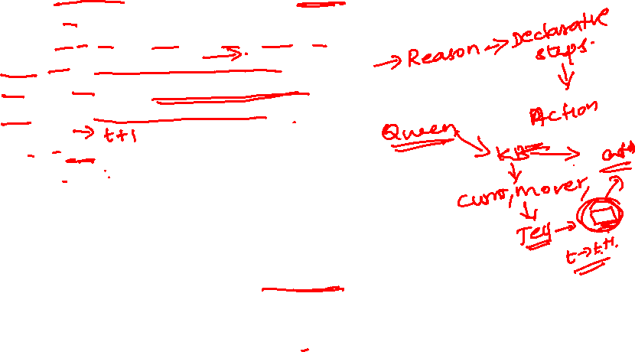
A simple knowledge-based agent
The agent must be able to:
  Represent states, actions, etc.
  Incorporate new percepts
  Update internal representations of the world
  Deduce hidden properties of the world
  Deduce appropriate actions

Slide 13


Wumpus World

Slide 14
Wumpus World PEAS description
Performance measure
  gold +1000, death -1000
  -1 per step, -10 for using the arrow
Environment
  Squares adjacent to wumpus are smelly
  Squares adjacent to pit are breezy
  Glitter iff gold is in the same square
  Shooting kills wumpus if you are facing it
  Shooting uses up the only arrow
  Grabbing picks up gold if in same square
  Releasing drops the gold in same square
Sensors: Stench, Breeze, Glitter, Bump, Scream
Actuators: Left turn, Right turn, Forward, Grab, Release, Shoot

Slide 15

Sensors: The agent has ﬁve sensors, each of which gives a single bit of information: –
In the square containing the wumpus and in the directly (not diagonally) adjacent squares, the agent will perceive a Stench. –
In the squares directly adjacent to a pit, the agent will perceive a Breeze. –
In the square where the gold is, the agent will perceive a Glitter. –
When an agent walks into a wall, it will perceive a Bump. –
When the wumpus is killed, it emits a woeful Scream that can be perceived anywhere in the cave.

Slide 16
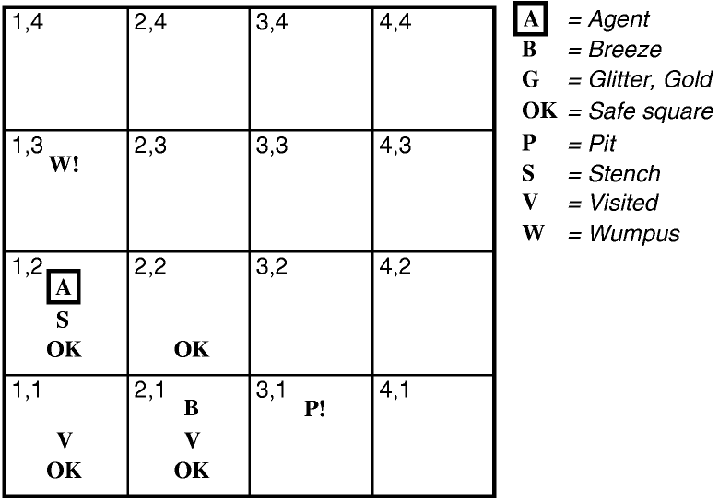
1. [None, None, None, None, None] –Neighbouring squares [1,2]and [2,1] are SAFE . . Let us suppose the agent decides to move forward to [2,1]. The agent perceives a breeze (denoted by “B”) in [2,1], so there must be a pit in a neighboring square. The pit cannot be in [1,1], by the rules of the game, so there must be a pit in [2,2] or [3,1] or both.
2. [None, Breeze, None, None, None].
3. [Stench, None, None, None, None]
4. [Stench, Breeze, Glitter, None, None].

Slide 17
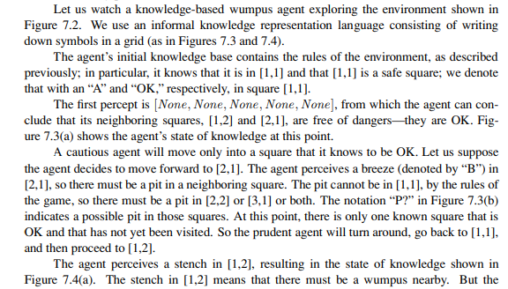

Slide 18
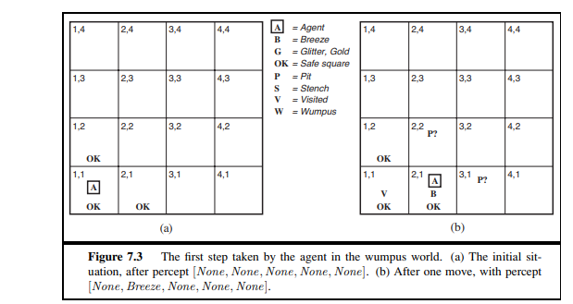


Slide 19
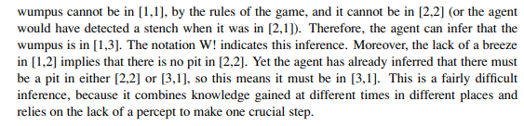
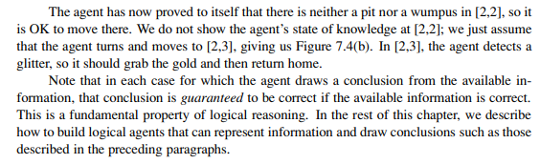

Slide 20
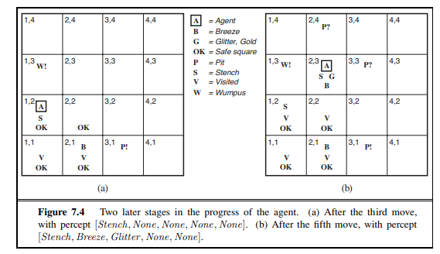

Slide 21
Wumpus world characterization
Fully Observable No – only local perception
Deterministic Yes – outcomes exactly specified
Episodic No – sequential at the level of actions
Static Yes – Wumpus and Pits do not move
Discrete Yes
Single-agent? Yes – Wumpus is essentially a natural feature

Slide 22

Exploring a wumpus world

Slide 23

Exploring a wumpus world

Slide 24

Exploring a wumpus world

Slide 25

Exploring a wumpus world

Slide 26
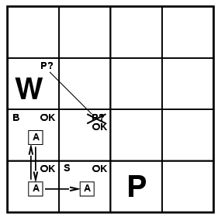
Exploring a wumpus world

Slide 27
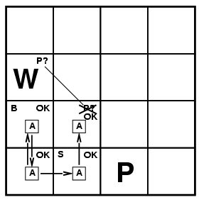
Exploring a wumpus world

Slide 28
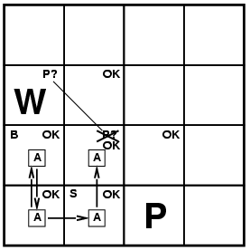
Exploring a wumpus world

Slide 29
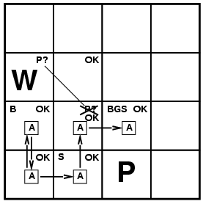
Exploring a wumpus world

Slide 30
Logic in general
Logics are formal languages for representing information such that conclusions can be drawn
Syntax defines the sentences in the language
Semantics define the "meaning" of sentences;
  i.e., define truth of a sentence in a world
E.g., the language of arithmetic
    x+2 ≥ y is a sentence; x2+y > {} is not a sentence
    x+2 ≥ y is true iff the number x+2 is no less than the number y
    x+2 ≥ y is true in a world where x = 7, y = 1
    x+2 ≥ y is false in a world where x = 0, y = 6

Slide 31
Entailment
Entailment means that one thing follows from another:
KB ╞ α
Knowledge base KB entails sentence α if and only if α is true in all worlds where KB is true
  E.g., the KB containing “the Giants won” and “the Reds won” entails “Either the Giants won or the Reds won”
  E.g., x+y = 4 entails 4 = x+y
  Entailment is a relationship between sentences (i.e., syntax) that is based on semantics

Slide 32

Models
Logicians typically think in terms of models, which are formally structured worlds with respect to which truth can be evaluated
We say M is a model of a sentence α if α is true in M
M(α) is the set of all models of α
Then KB ╞ α iff M(KB) ⊆ M(α)
  E.g. KB = Giants won and Reds
  won α = Giants won

Slide 33
We can apply the same kind of analysis to the wumpus-world reasoning example given in the preceding section.
Consider the situation in Figure 7.3(b): the agent has detected nothing in [1,1] and a breeze in [2,1]. These percepts, combined with the agent’s knowledge of the rules of the wumpus world, constitute the KB. The agent is interested (among other things) in whether the adjacent squares [1,2], [2,2], and [3,1] contain pits.
Each of the three squares might or might not contain a pit, so (for the purposes of this example) there are 2^3 = 8 possible models. There are eight models.

Slide 34


Entailment in the wumpus world
Situation after detecting nothing in [1,1], moving right, breeze in [1,2]
Consider possible models for KB assuming only pits
3 Boolean choices ⇒ 8 possible models

Slide 35

Wumpus models

Slide 36

Wumpus models
KB = wumpus-world rules + observations

Slide 37

Wumpus models
KB = wumpus-world rules + observations
α₁ = "[1,2] is safe", KB ╞ α₁, proved by model checking

Slide 38
Wumpus models
KB = wumpus-world rules + observations

Slide 39

Wumpus models
KB = wumpus-world rules + observations
α₂ = "[2,2] is safe", KB ╞ α₂

Slide 40
Inference
KB ├_{i} α = sentence α can be derived from KB by procedure i
Soundness: i is sound if whenever KB ├_{i} α, it is also true that KB╞ α
Soundness means that you cannot prove anything that's wrong.
Completeness: i is complete if whenever KB╞ α, it is also true that KB ├_{i} α
Completeness means that you can prove anything that's right.
Preview: we will define a logic (first-order logic) which is expressive enough to say almost anything of interest, and for which there exists a sound and complete inference procedure.
That is, the procedure will answer any question whose answer follows from what is known by the KB.
The algorithm is sound because it implements directly the deﬁnition of entailment, and complete because it works for any KB.

Slide 41
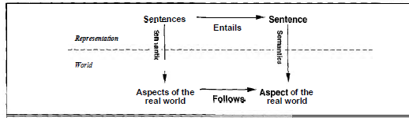

Slide 42
Propositional logic: Syntax
Propositional logic is the simplest logic – illustrates basic ideas (Boolean Logic)
The proposition symbols P₁, P₂ etc., are sentences
  If S is a sentence, ¬ S is a sentence (negation)
  If S₁ and S₂ are sentences, S₁ ∧ S₂ is a sentence (conjunction/and)
  If S₁ and S₂ are sentences, S₁ ∨ S₂ is a sentence (disjunction/or)
  If S₁ and S₂ are sentences, S₁ ⇒ S₂ is a sentence (implication/implies)
  If S₁ and S₂ are sentences, S₁ ⇔ S₂ is a sentence (biconditional-if and only if)

Slide 43
Propositional logic: Semantics
Each model specifies true/false for each proposition symbol
  E.g. P_{1,2} P_{2,2} P_{3,1}
  false true false
With these symbols, 8 possible models, can be enumerated automatically.
S₁ ∧ S₂ is true iff S₁ is true and S₂ is true
S₁ ∨ S₂ is true iff S₁is true or S₂ is true
S₁ ⇒ S₂ is true iff S₁ is false or S₂ is true
i.e., is false iff S₁ is true and S₂ is false
S₁ ⇔ S₂ is true iff S₁⇒S₂ is true andS₂⇒S₁ is true
¬P_{1,2} ∧ (P_{2,2} ∨ P_{3,1}) = true ∧ (true ∨ false) = true ∧ true = true
Simple recursive process evaluates an arbitrary sentence, e.g.,
Rules for evaluating truth with respect to a model m:
➢S is true iff S is false

Slide 44
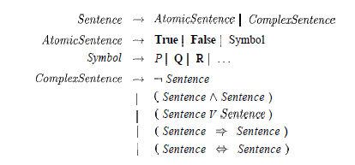
BNF(Backus-Normal Form)
Formal grammar of propositional logic

Slide 45

Truth tables for connectives

Slide 46
Wumpus world sentences
Let P_{i,j} be true if there is a pit in [i, j].
Let B_{i,j} be true if there is a breeze in [i, j].
  ¬ P_{1,1}
  ¬B_{1,1}
  B_{2,1}
"Pits cause breezes in adjacent squares"
  B_{1,1} ⇔ (P_{1,2} ∨ P_{2,1})
  B_{2,1} ⇔ (P_{1,1} ∨ P_{2,2} ∨ P_{3,1})

Slide 47

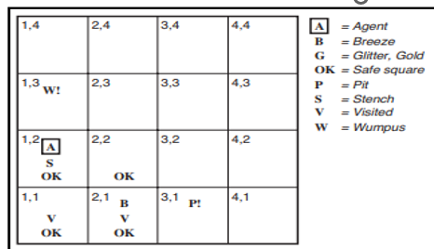
Truth tables for inference

Slide 48
A simple inference procedure
Figure 7.9 reproduces in a more precise form the reasoning illustrated in Figure 7.5.
A general algorithm for deciding entailment in propositional logic is shown in Figure 7.10 (next sldie).
TT-ENTAILS? performs a recursive enumeration of a finite space of assignments to symbols.
The algorithm is sound because it implements directly the definition of entailment, and complete because it works for any KB and α and always terminates—there are only finitely many models to examine.

Slide 49

Inference by enumeration
Depth-first enumeration of all models is sound and complete
For n symbols, time complexity is O(2^{n}), space complexity is O(n)

Slide 50
A simple inference procedure
Figure 7.9 reproduces in a more precise form the reasoning illustrated in Figure 7.5.
A general algorithm for deciding entailment in propositional logic is shown in Figure 7.10 (next sldie).
TT-ENTAILS? performs a recursive enumeration of a finite space of assignments to symbols.
The algorithm is sound because it implements directly the definition of entailment, and complete because it works for any KB and α and always terminates—there are only finitely many models to examine.

Slide 51
Propositional Theorem Proving
By enumerating models one can determine entailment through model checking and showing that the sentence must hold in all models.
Entailment can be done by theorem proving—applying rules of inference directly to the sentences in our knowledge base to construct a proof of the desired sentence without consulting models.
If the number of models is large but the length of the proof is short, then theorem proving can be more efficient than model checking.

Slide 52

Logical equivalence
Two sentences are {logically equivalent} iff true in same models: α ≡ ß iff α╞ β and β╞ α

Slide 53
Validity and Satisfiability
A sentence is valid if it is true in all models,
  e.g., True, A ∨¬A, A ⇒ A, (A ∧ (A ⇒ B)) ⇒ B
Validity is connected to inference via the Deduction Theorem:
  KB ╞ α if and only if (KB ⇒ α) is valid
If a sentence is Valid then it is tautology
A sentence is satisfiable if it is true in some model
  e.g., A∨ B, C
A sentence is unsatisfiable if it is true in no models
  e.g., A∧¬A
Satisfiability is connected to inference via the following:
  KB ╞ α if and only if (KB ∧¬α) is unsatisfiable

Slide 54
Validity and Satisfiability
Satisfiability can be checked by enumerating the possible models until one is found that satisfies the sentence.
The problem of determining the satisfiability of sentences in propositional logic—the SAT problem—was the first problem proved to be NP-complete.
Many problems in computer science are really satisfiability problems.
Validity and satisfiability are of course connected: α is valid iff ￢α is unsatisfiable;
  contrapositively, α is satisfiable iff ￢α is not valid.

Slide 55
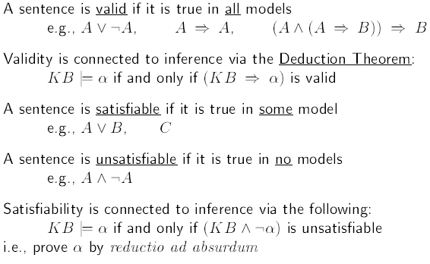
Validity and Satisfiability
Summary

Slide 56
Proof methods
Proof methods divide into (roughly) two kinds:
  Application of inference rules
    Legitimate (sound) generation of new sentences from old
    Proof = a sequence of inference rule applications
    Can use inference rules as operators in a standard search algorithm
    Typically require transformation of sentences into a normal form
  Model checking
    truth table enumeration (always exponential in n)
    improved backtracking, e.g., Davis--Putnam-Logemann-Loveland (DPLL)
    heuristic search in model space (sound but incomplete)
    e.g., min-conflicts-like hill-climbing algorithms

Slide 57

Inference and proofs
Inference rules that can be applied to derive a proof— a chain of conclusions that leads to the desired goal.
The best-known rule is called Modus Ponens
(Latin for mode that affirms) and is written as
  The notation means that, whenever any sentences of the form α ⇒ β and α are given, then the sentence β can be inferred.
Ex. If (WumpusAhead ∧WumpusAlive) ⇒ Shoot and (WumpusAhead ∧WumpusAlive) are given, then Shoot can be inferred.

Slide 58

Inference Rules
Inference rule : And-Elimination - which says that, from a conjunction, any of the conjuncts can be inferred:
For example, from (WumpusAhead ∧WumpusAlive), WumpusAlive can be inferred.
By considering the possible truth values of α and β , one can easily show once and for all that Modus Ponens and And-Elimination are sound.
These rules can then be used in any particular instances where they apply, generating sound inferences without the need for enumerating models.

Slide 59

Inference Rules
All of the logical equivalences in Figure 7.11 can be used as inference rules.
  For example, the equivalence for biconditional elimination yields the two inference rules

Slide 60
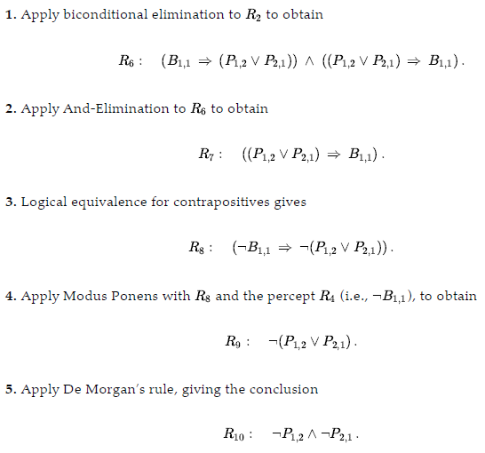
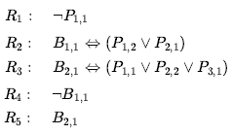
Inference rules and equivalences in Wumpus world
We start with the knowledge base containing R₁ through R₅ and show how to prove , ¬P_{1,2} that is, there is no pit in [1,2]:
R₁₀ : Neither [1,2] nor [2,1] contains a pit.
Any of the search algorithms can be used to find a sequence of steps that constitutes a proof like this.

Slide 61
Proof problem
INITIAL STATE: the initial knowledge base.
ACTIONS: the set of actions consists of all the inference rules applied to all the sentences that match the top half of the inference rule.
RESULT: the result of an action is to add the sentence in the bottom half of the inference rule.
GOAL: the goal is a state that contains the sentence we are trying to prove.

Slide 62
Proof problem
Thus, searching for proofs is an alternative to enumerating models.
In many practical cases finding a proof can be more efficient because the proof can ignore irrelevant propositions, no matter how many of them there are.
For example, the proof just given leading to ¬P_{1,2} ∧ ¬P_{2,1}does not mention the propositions B2,1, P1,1, P2,2, or P3,1.
They can be ignored because the goal proposition, P1,2 , appears only in sentence R2; appear only in R4 and R2 so , R1, R3 and R5 have no bearing on the proof.
The same would hold even if we added a million more sentences to the knowledge base; the simple truth-table algorithm, on the other hand, would be overwhelmed by the exponential explosion of models.
One final property of logical systems is monotonicity, which says that the set of entailed sentences can only increase as information is added to the knowledge base. For any sentences α and β,
if KB ⊨ α then KB ∧ β ⊨ α .

Slide 63
Proof problem
We also have the following useful result:
α ⊨ β if and only if the sentence (α ∧ ￢β) is unsatisfiable.
Proving β from α by checking the unsatisfiability of (α ∧ ￢β) corresponds exactly to the standard mathematical proof technique of reductio ad absurdum (literally, “reduction to an absurd thing”).
It is also called proof by refutation or proof by contradiction.
One assumes a sentence to be false and shows that this leads to a contradiction with known axioms .
This contradiction is exactly what is meant by saying that the sentence is (α ∧ ￢β) unsatisfiable.

Slide 64
Proof problem
For example, suppose the knowledge base contains the additional assertion stating that there are exactly eight pits in the world.
  This knowledge might help the agent draw additional conclusions, but it cannot invalidate any conclusion already inferred—such as the conclusion that there is no pit in [1,2].
Monotonicity means that inference rules can be applied whenever suitable premises are found in the knowledge base—the conclusion of the rule must follow regardless of what else is in the knowledge base.

Slide 65
Proof by resolution
We have argued that the inference rules covered so far are sound, but we have not discussed the question of completeness for the inference algorithms that use them.
Search algorithms such as iterative deepening search are complete in the sense that they will find any reachable goal, but if the available inference rules are inadequate, then the goal is not reachable—no proof exists that uses only those inference rules.
For example, if we removed the biconditional elimination rule, the proof in the preceding section would not go through.
The current section introduces a single inference rule, resolution, that yields a complete inference algorithm when coupled with any complete search algorithm.

Slide 66
Proof by resolution
We begin by using a simple version of the resolution rule in the wumpus world.
Let us consider the steps leading up to Figure 7.4(a) : the agent returns from [2,1] to [1,1] and then goes to [1,2], where it perceives a stench, but no breeze.
We add the following facts to the knowledge base:

Slide 67
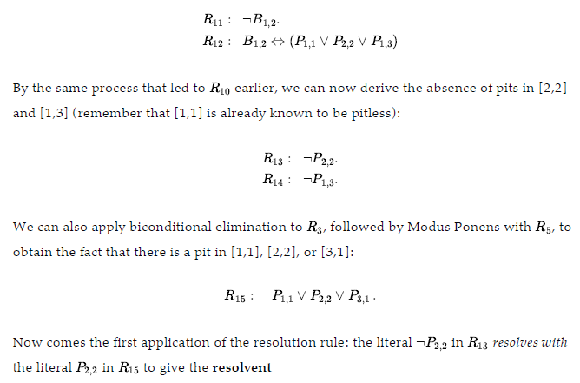
Proof by resolution
We add the following facts to the knowledge base:

Slide 68
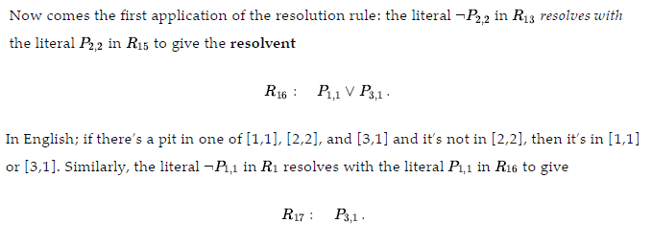
Proof by resolution
Example continued:

Slide 69

Resolution
Conjunctive Normal Form (CNF)
  conjunction of disjunctions of literals
  clauses
  E.g., (A ∨ ¬B) ∧ (B ∨ ¬C ∨ ¬D)
Resolution inference rule (for CNF):
l_{i} ∨… ∨ l_{k}, m₁ ∨ … ∨ m_{n}
l_{i} ∨ … ∨ l_{i-1} ∨ l_{i+1} ∨ … ∨ l_{k} ∨ m₁ ∨ … ∨ m_{j-1} ∨ m_{j+1} ∨... ∨ m_{n}
where l_{i} and m_{j} are complementary literals.
E.g., P_{1,3} ∨ P_{2,2}, ¬P_{2,2}
P_{1,3}
Soundness means that you cannot prove anything that's wrong.
Completeness means that you can prove anything that's right.
Resolution is sound and complete for propositional logic

Slide 70
Resolution
Soundness of resolution inference rule:
¬(l_{i} ∨ … ∨ l_{i-1} ∨ l_{i+1} ∨ … ∨ l_{k}) ⇒ l_{i}
m_{j} ⇒ (m₁ ∨ … ∨ m_{j-1} ∨ m_{j+1} ∨... ∨ m_{n})
¬(l_{i} ∨ … ∨ l_{i-1} ∨ l_{i+1} ∨ … ∨ l_{k}) ⇒ (m₁ ∨ … ∨ m_{j-1} ∨ m_{j+1} ∨... ∨ m_{n})

Slide 71
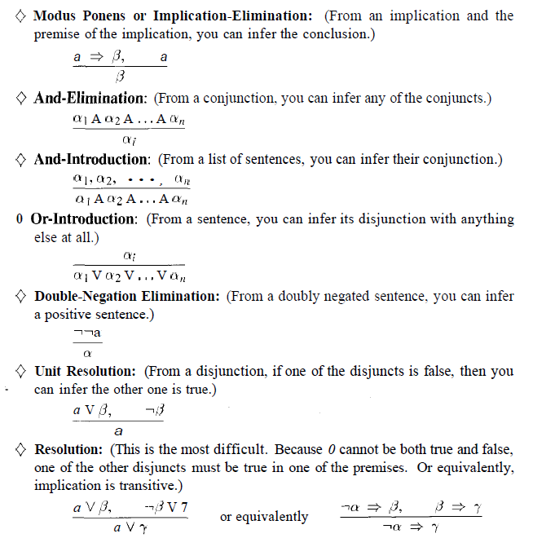
Rules for Inference for Propositional Logic

Slide 72
Conversion to CNF
B_{1,1} ⇔ (P_{1,2} ∨ P_{2,1})β
Eliminate ⇔, replacing α ⇔ β with (α ⇒ β)∧(β ⇒ α).
  (B_{1,1} ⇒ (P_{1,2} ∨ P_{2,1})) ∧ ((P_{1,2} ∨ P_{2,1}) ⇒ B_{1,1})
2. Eliminate ⇒, replacing α ⇒ β with ¬α∨ β.
  (¬B_{1,1} ∨ P_{1,2} ∨ P_{2,1}) ∧ (¬(P_{1,2} ∨ P_{2,1}) ∨ B_{1,1})
3. Move ¬ inwards using de Morgan's rules and double-negation:
  (¬B_{1,1} ∨ P_{1,2} ∨ P_{2,1}) ∧ ((¬P_{1,2} ∧ ¬P_{2,1}) ∨ B_{1,1})
4. Apply distributivity law (∧ over ∨) and flatten:
  (¬B_{1,1} ∨ P_{1,2} ∨ P_{2,1}) ∧ (¬P_{1,2} ∨ B_{1,1}) ∧ (¬P_{2,1} ∨ B_{1,1})

Slide 73
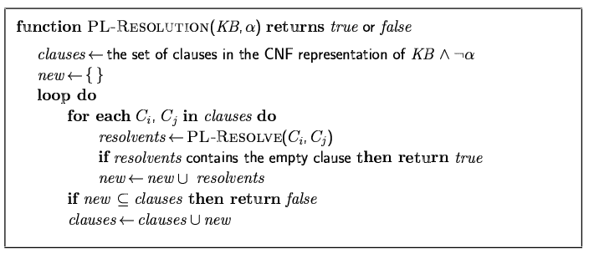
Resolution algorithm
Proof by contradiction, i.e., show KB∧¬α unsatisfiable

Slide 74

Resolution example
KB = (B_{1,1} ⇔ (P_{1,2}∨ P_{2,1})) ∧¬ B_{1,1} α = ¬P_{1,2}
α ╞ β if and only if the sentence (α ∧¬ β ) is unsatisfiabile (refutation or proof by contradiction)

Slide 75
Forward and backward chaining
Horn Form (restricted)
  KB = conjunction of Horn clauses
        proposition symbol; or
        (conjunction of symbols) ⇒ symbol
  E.g., C ∧ (B ⇒ A) ∧ (C ∧ D ⇒ B)
Modus Ponens (for Horn Form): complete for Horn KBs
α₁, … ,α_{n}, α₁ ∧ … ∧ α_{n} ⇒ β
β
Can be used with forward chaining or backward chaining.
These algorithms are very natural and run in linear time
  Horn clause =

Slide 76
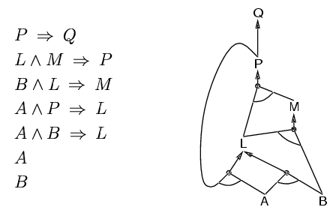
Forward chaining
Idea: fire any rule whose premises are satisfied in the KB,
  add its conclusion to the KB, until query is found

Slide 77
Forward chaining
The forward-chaining algorithm PL-FC-ENTAILS?(KB, q) determines if a single proposition symbol q—the query—is entailed by a knowledge base of definite clauses.
It begins from known facts (positive literals) in the knowledge base. If all the premises of an implication are known, then its conclusion is added to the set of known facts.
For example, if L1,1 and Breeze are known and (L1,1 ∧ Breeze) ⇒ B1,1 is in the knowledge base, then B1,1 can be added.
This process continues until the query q is added or until no further inferences can be made.
The detailed algorithm is shown below the main point to remember is that it runs in linear time

Slide 78
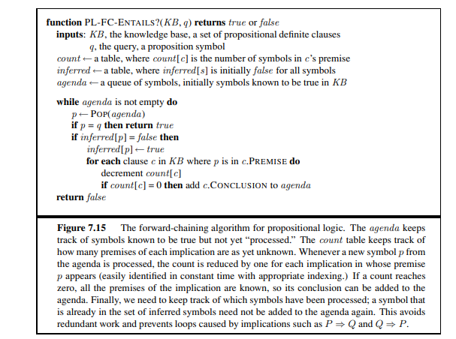

Slide 79
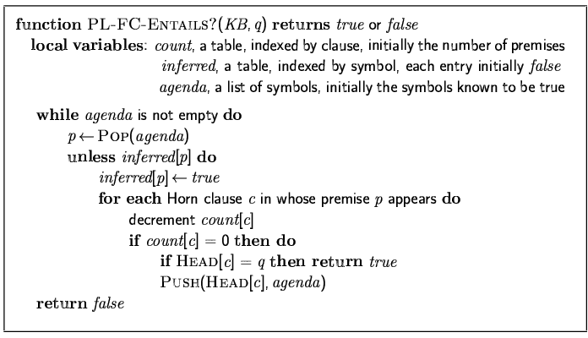
Forward chaining algorithm
Forward chaining is sound and complete for Horn KB

Slide 80
Forward chaining is an example of the general concept of data-driven reasoning—that is, reasoning in which the focus of attention starts with the known data.
It can be used within an agent to derive conclusions from incoming percepts, often without a specific query in mind. For example, the wumpus agent might TELL its percepts to the knowledge base an incremental forward-chaining algorithm in which new facts can be added to the agenda to initiate new inferences.
In humans, a certain amount of data-driven reasoning occurs as new information arrives.
For example, if I am indoors and hear rain starting to fall, it might occur to me that the picnic will be canceled.
Yet it will probably not occur to me that the seventeenth petal on the largest rose in my neighbor’s garden will get wet; humans keep forward chaining under careful control, lest they be swamped with irrelevant consequences.

Slide 81
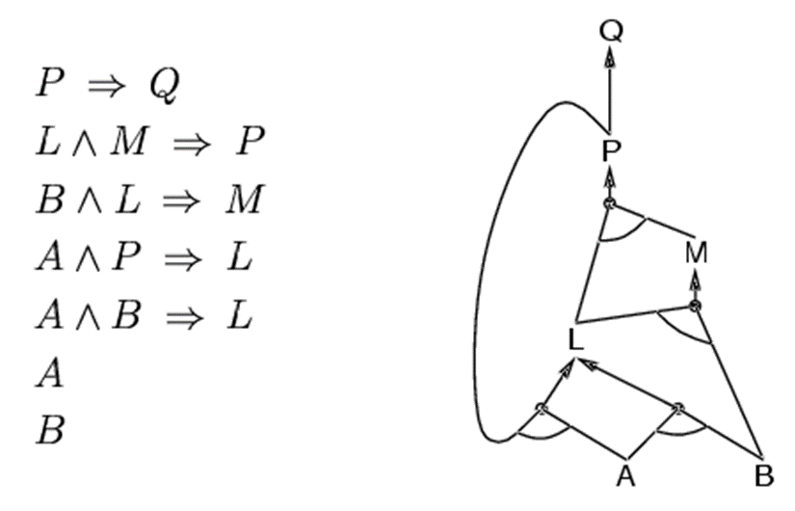
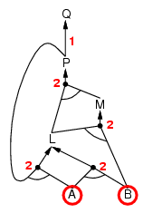
Forward chaining example

Slide 82
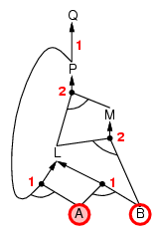
Forward chaining example

Slide 83
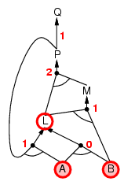
Forward chaining example

Slide 84
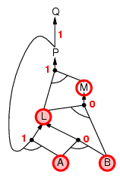
Forward chaining example

Slide 85
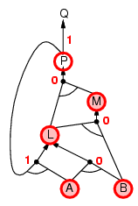
Forward chaining example

Slide 86
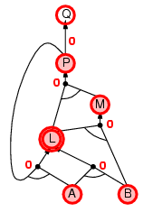
Forward chaining example

Slide 87
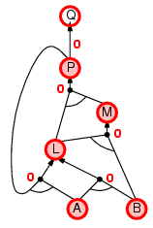
Forward chaining example

Slide 88

Forward chaining example

Slide 89
Proof of completeness
FC derives every atomic sentence that is entailed by KB
  FC reaches a fixed point where no new atomic sentences are derived
  Consider the final state as a model m, assigning true/false to symbols
  Every clause in the original KB is true in m
    a₁ ∧ … ∧ a_{k ⇒} b
  Hence m is a model of KB
  If KB╞ q, q is true in every model of KB, including m

Slide 90
Backward chaining
Idea: work backwards from the query q:
    check if q is known already, or
    prove by BC all premises of some rule concluding q
Avoid loops: check if new sub-goal is already on the goal stack
Avoid repeated work: check if new sub-goal
  has already been proved true, or
  has already failed
to prove q by BC,

Slide 91
The backward-chaining algorithm, as its name suggests, works backward from the query.
If the query q is known to be true, then no work is needed. Otherwise, the algorithm finds those implications in the knowledge base whose conclusion is q.
If all the premises of one of those implications can be proved true (by backward chaining), then q is true.
When applied to the query Q in Figure 7.16, it works back down the graph until it reaches a set of known facts, A and B, that forms the basis for a proof.
The algorithm is essentially identical to the AND-OR-GRAPH-SEARCH algorithm. As with forward chaining, an efficient implementation runs in linear time.
Backward chaining is a form of goal-directed reasoning. It is useful for answering GOAL-DIRECTED REASONING specific questions such as “What shall I do now?” and “Where are my keys?” Often, the cost of backward chaining is much less than linear in the size of the knowledge base, because the process touches only relevant facts

Slide 92
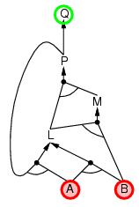
Backward chaining example

Slide 93
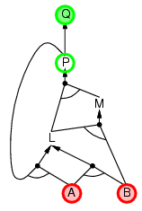
Backward chaining example

Slide 94
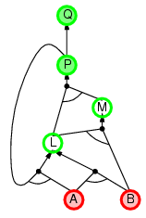
Backward chaining example

Slide 95
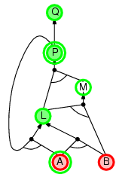
Backward chaining example

Slide 96
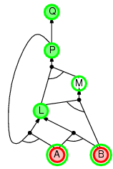
Backward chaining example

Slide 97
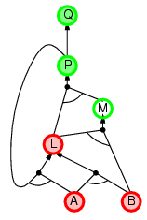
Backward chaining example

Slide 98
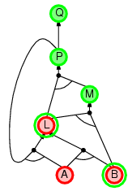
Backward chaining example

Slide 99
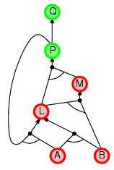
Backward chaining example

Slide 100
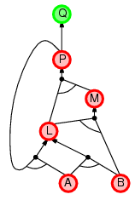
Backward chaining example

Slide 101
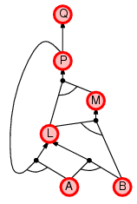
Backward chaining example

Slide 102
Forward vs. backward chaining
FC is data-driven, automatic, unconscious processing,
  e.g., object recognition, routine decisions
May do lots of work that is irrelevant to the goal
BC is goal-driven, appropriate for problem-solving,
  e.g., Where are my keys? How do I get into a PhD program?
Complexity of BC can be much less than linear in size of KB

